Slide 1
Magenic Masters React Assignment #6 & Final Project
Feb 22, 2017
Tim Chan / Mily Opeña

Slide 2
Assignment #6
Create a Jest snapshot test for one of your components.
Create a Jest Enzyme shallow rendering test for one of your components.
Create a Jest Enzyme mount rendering test for one of your components.

Slide 3
Final Project

Slide 4
About
A way to test everything you learn throughout the course
We will just give the specifications, you are free to use any techniques you learned on React
Deadline for submission is on March 16, 2017

Slide 5
Reminders
You can use Redux, but we strongly recommend that you familiarize yourself with Flux
You can use ES5, ES6 or mixed.
Do not check-in unfinished work, we are still checking your assignments (create a branch for your Final Project)
Please include “React Final Project” on your message title

Slide 6
Final Project Specifications

Slide 7
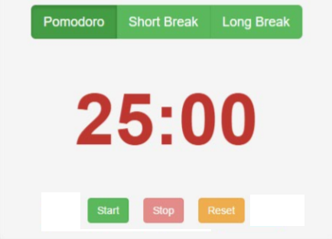
Timer
User should be able to select between 3 timers: Pomodoro (25 mins), Short Break (5 mins), Long Break (15 mins)
User should be able to start, stop and reset the selected timer.
User should able to create a timer configuration
Set a name for the configuration
Override the default durations for Pomodoro, Short Break and Long Break.
Reset to default settings
User should be alerted when the timer duration elapses.

Slide 8
Tasks
User should be able to create tasks.
User should be able to determine if a task is not yet started, in progress and completed.
User should be able to set the priority of the tasks.
User should be able to set the default timer configuration of the task.
User should be able to see prioritized tasks in all of the pages of the app
User should be able to add tasks in all of the pages of the app.

Slide 9
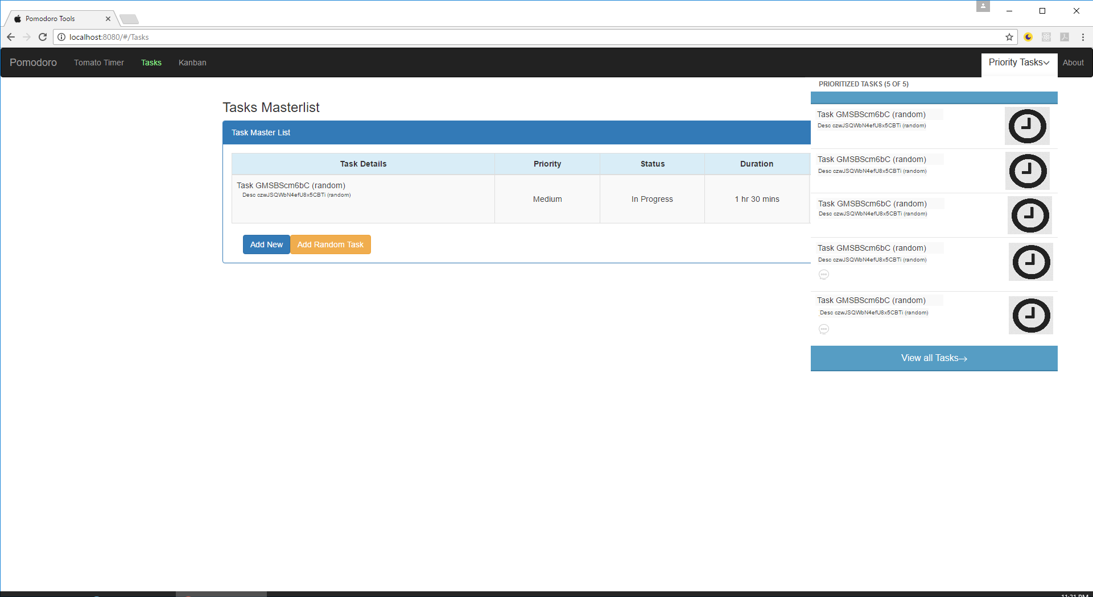
Tasks

Slide 10
Dashboard
User should be able to select a pending/in progress task for the timer.
The timer should reflect the task default timer configuration.
For the Pomodoro timer, when the user stop the timer is should record the duration elapsed to the task.
For the short break timer, when the user stop the timer is should record the duration elapsed to the task.
For the long break timer, it should not record something.
User should be able to complete a task.
User should be able to select a task from the prioritized task list and go to the dashboard with the selected task preselected.

Slide 11
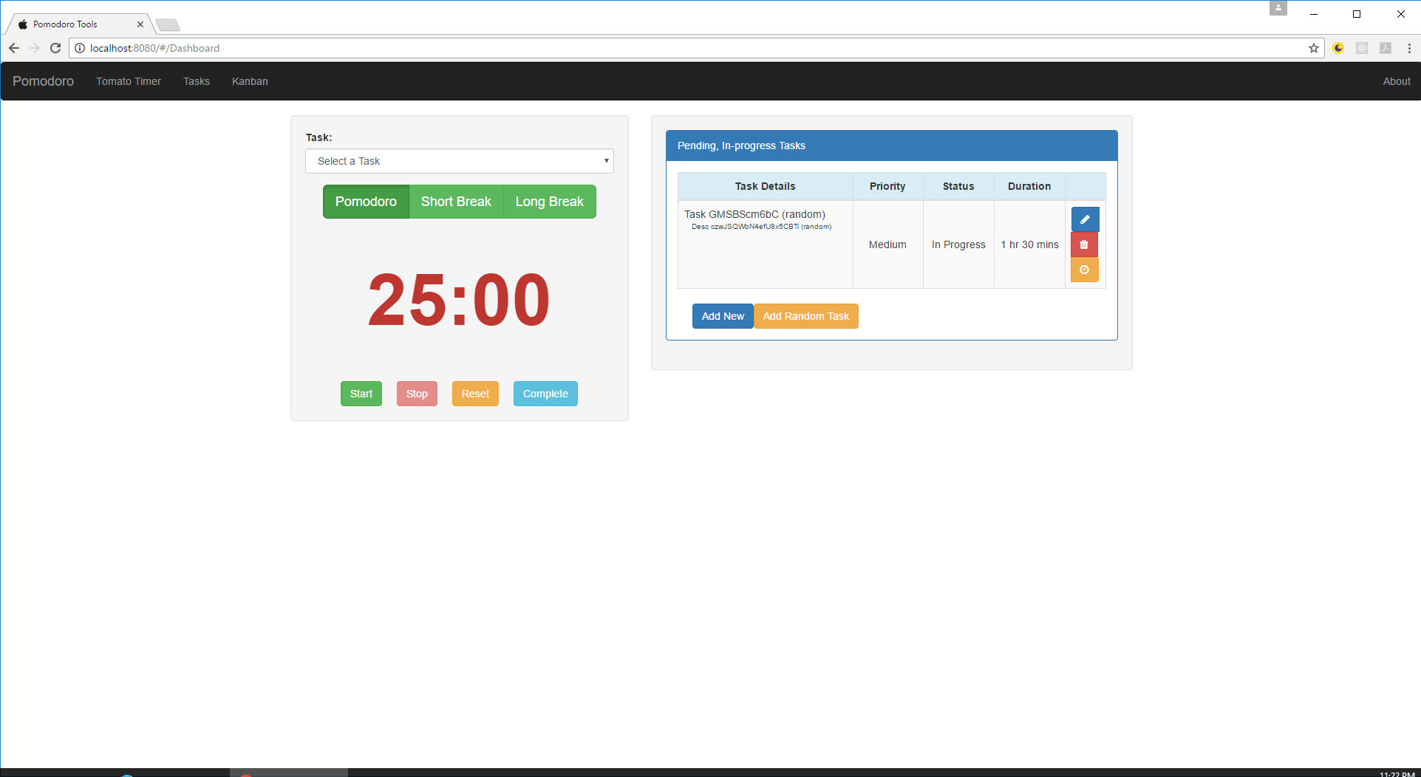
Dashboard

Slide 12
Grading System
60% - Adherence to Project Specification
20% - Proper usage of Props, States and Life Cycle events
20% - Correct Flux implementation

Slide 13
Bonus Points
Top 3 UX design => +10 pts to Project grade
First 5 to submit => +10 pts to Project grade
Additional requirement: user should still be notified when the started timer duration elapses even after navigating to other pages. => +20 pts to Project grade
Good unit tests coverage (70%) => +10 pts to Project grade
Fully ES6 application => +2 pts to Project grade

